Slide 1

SIT1304
CLOUD COMPUTING UNIT 5

Slide 2

CLOUD SECURITY

Slide 3
CLOUD SECURITY
Cloud security is the protection of data, applications, and infrastructures involved in cloud computing.
High-level security concerns—
like unauthorized data exposure and leaks, weak access controls, susceptibility to attacks, and availability disruptions—affect traditional IT and cloud systems.

Slide 4
CLOUD SECURITY
Like any computing environment, cloud security involves maintaining adequate preventative protections so you:
Know that the data and systems are safe.
Can see the current state of security.
Know immediately if anything unusual happens.
Can trace and respond to unexpected events.

Slide 5
CLOUD SECURITY
Why Cloud Security is Different
Dissolving Perimeters
Sophisticated threat landscape

Slide 6
SECURITY THREATS AND SOLUTIONS:
Absence of adequate encryption
Feeble security management
Poor data redundancy
Data leak

Slide 7
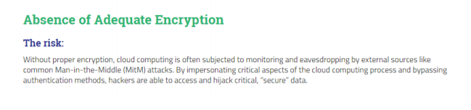

SECURITY THREATS AND SOLUTIONS

Slide 8
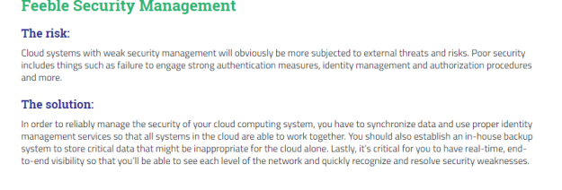
SECURITY THREATS AND SOLUTIONS

Slide 9
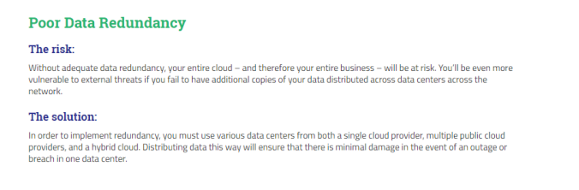
SECURITY THREATS AND SOLUTIONS

Slide 10
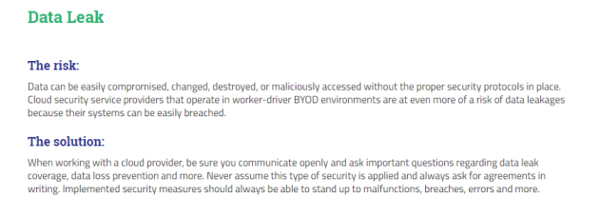
SECURITY THREATS AND SOLUTIONS

Slide 11
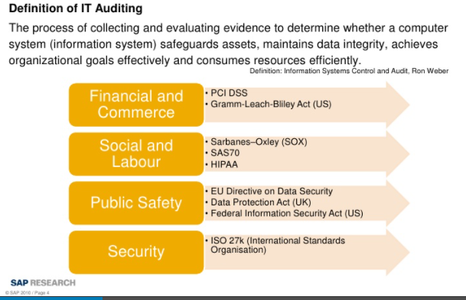
AUDITING PROTOCOL

Slide 12



CLOUD AUDITING

Slide 13
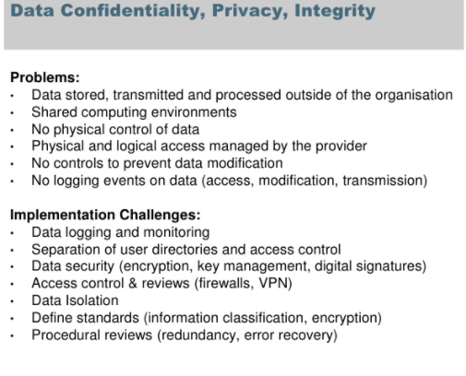
CLOUD AUDITING

Slide 14
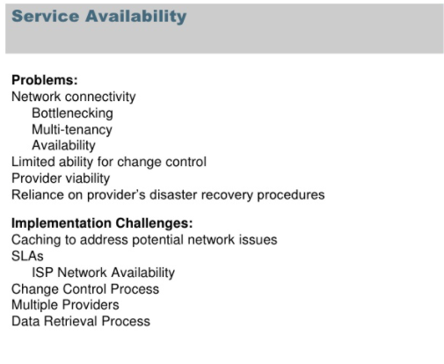
CLOUD AUDITING

Slide 15
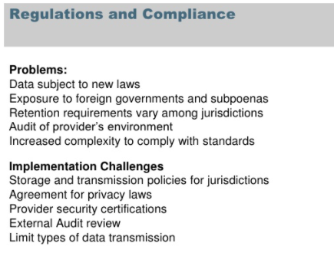
CLOUD AUDITING

Slide 16
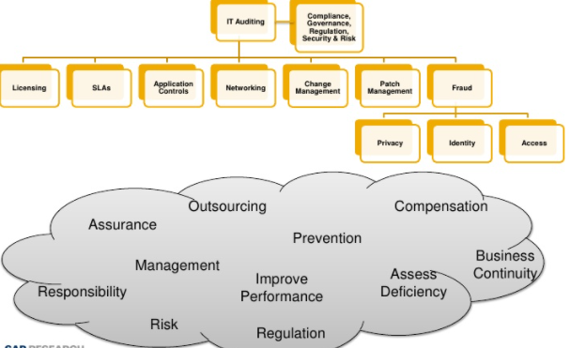
Problems arises from cloud auditing

Slide 17
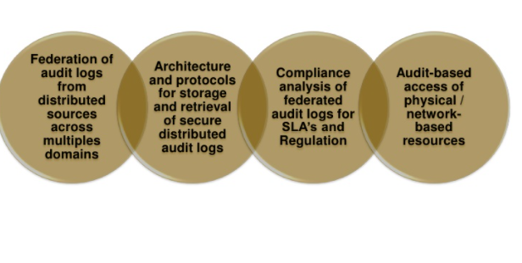
Challenges for cloud auditing
Reference : https://www.slideshare.net/jonathansinclair86/cloud-auditing

Slide 18
Homomorphic Encryption
Homomorphic encryption is a form of encryption that allows computation on ciphertexts, generating an encrypted result which, when decrypted, matches the result of the operations as if they had been performed on the plaintext
Homomorphic encryption is a form of encryption that permits users to perform computations on its encrypted data without first decrypting it.
homomorphic encryption is a method of encryption that allows any data to remain encrypted while it’s being processed and manipulated.
It enables you or a third party (such as a cloud provider) to apply functions on encrypted data without needing to reveal the values of the data.

Slide 19
Types of Homomorphic Encryption
There are three main types of homomorphic encryption. The primary difference between them boils down to the types and frequency of mathematical operations that can be performed on their ciphertext. The three types of homomorphic encryption include:
Partially Homomorphic Encryption
Somewhat Homomorphic Encryption
Fully Homomorphic Encryption

Slide 20
Partially homomorphic encryption (PHE)
Partially homomorphic encryption (PHE) helps sensitive data remain confidential by only allowing selected mathematical functions to be performed on encrypted values.
This means that one operation can be performed an unlimited number of times on the ciphertext.

Slide 21
Somewhat homomorphic encryption (SHE)
A somewhat homomorphic encryption (SHE) scheme is one that supports limited operations (for example, either addition or multiplication) up to a certain complexity, but these operations can only be performed a set number of times

Slide 22
Fully homomorphic encryption (FHE)
Fully homomorphic encryption (FHE) is an encryption scheme that enables analytical functions to be run directly on encrypted data while yielding the same encrypted results as if the functions were run on plaintext.

Slide 23
DOS ATTACKS:
A denial-of-service (DoS) is any type of attack where the attackers (hackers) attempt to prevent legitimate users from accessing the service.
In a DoS attack, the attacker usually sends excessive messages asking the network or server to authenticate requests that have invalid return addresses.
The network or server will not be able to find the return address of the attacker when sending the authentication approval, causing the server to wait before closing the connection.
When the server closes the connection, the attacker sends more authentication messages with invalid return addresses. Hence, the process of authentication and server wait will begin again, keeping the
network or server busy.

Slide 24
DoS attack
A DoS attack can be done in a several ways. The basic types of DoS attack include:
1. Flooding the network to prevent legitimate network traffic
2. Disrupting the connections between two machines, thus preventing access to a service
3. Preventing a particular individual from accessing a service.
4. Disrupting a service to a specific system or individual
5. Disrupting the state of information, such resetting of TCP sessions

Slide 25
DoS attacks can cause the following problems:
Ineffective services
Inaccessible services
Interruption of network traffic
Connection interference

Slide 26
FAULY TOLERENCE IN CLOUD COMPUTING:
Fault tolerance in cloud computing is largely the same (conceptually) as in private or hosted environments.
Meaning that it simply means the ability of your infrastructure to continue providing service to underlying applications even after the failure of one or more component pieces in any layer.

Slide 27
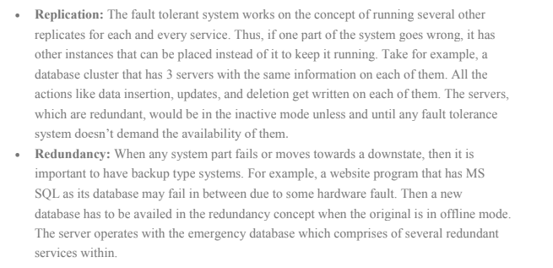
Main Concepts behind Fault Tolerance in Cloud Computing System

Slide 28
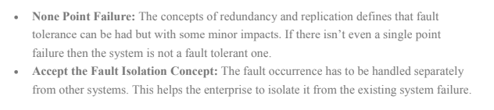
Major Attributes of Fault Tolerance in Cloud Computing

Slide 29
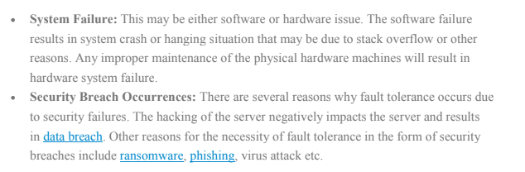
Existence of Fault Tolerance in Cloud Computing

Slide 30
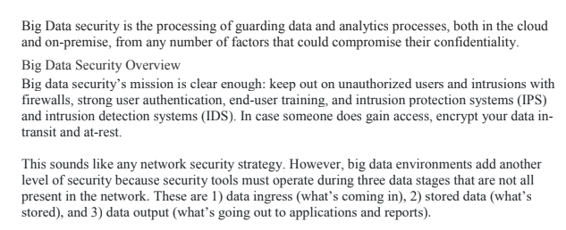
BIG DATA SECURITY

Slide 31
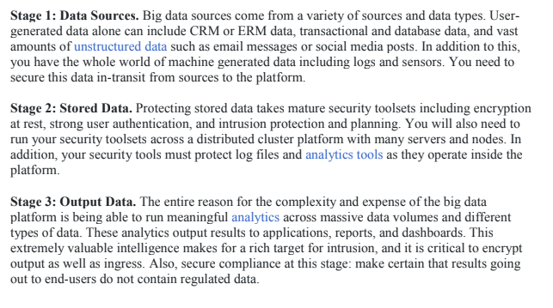
BIGDATA SECURITY

Slide 32
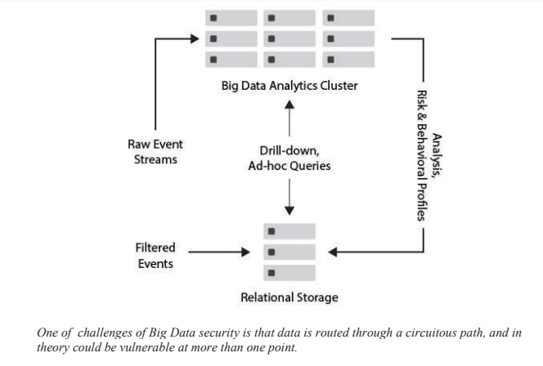
BIGDATA SECURITY

Slide 33
Assignment
Read about cloud computing in India

